Slide 1
Optimizing the path to your PhD
Maintaining a research notebook: how and why?
Randy Olson
January 24th, 2013
Notes:
Most of you probably already maintain a research notebook, so this should be a brief review of why you do it.

Slide 2
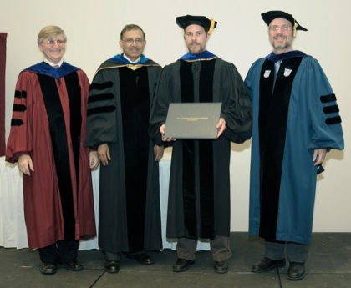
Everyone’s goal
ltsp.edu/
Notes:
Goal: one day dress up in a fancy robe and stand around talking to a bunch of old people until they finally hand you your PhD.

Slide 3
Tips for graduating on-time
Begin with the end in mind
You have no obligation to write an important or even useful thesis
Write!
Exercise regularly
Enjoy your "play time”
Talk to others about your problems
Record your progress
…
http://www.schonlau.net/finishphd.html
Notes:
Listed among the top 10 in every list of tips on how to graduate with your PhD on-time.

Slide 4
Benefits of research notebooks
Organize your ideas
Measure your progress
Visualize your data
Don’t repeat your work
Makes your advisor happy

Slide 5
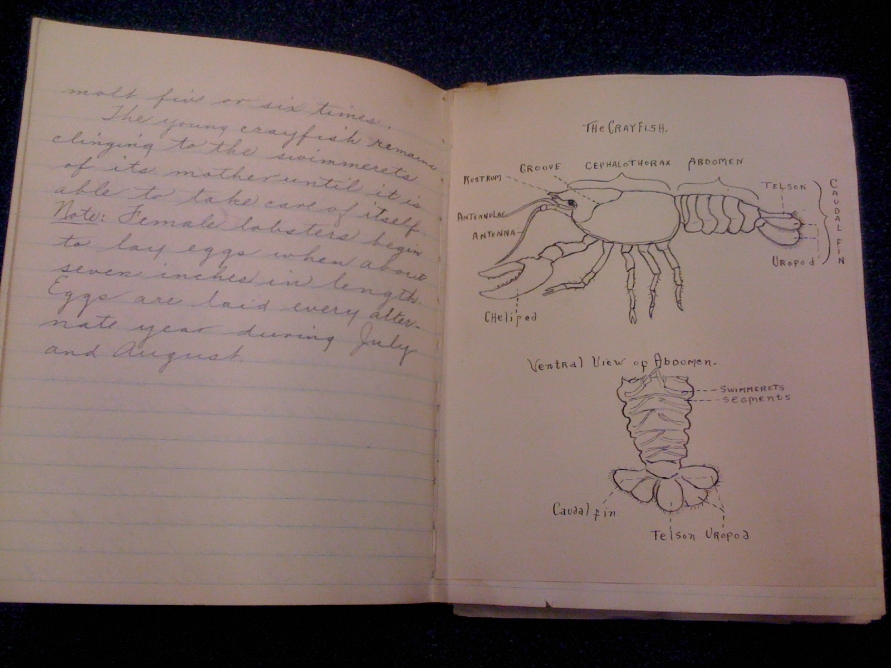
Ye olden days
brooklynhistory.org
Notes:
Physical notebooks bulky, messy, difficult to revise. Worst of all, you can LOSE them.

Slide 6
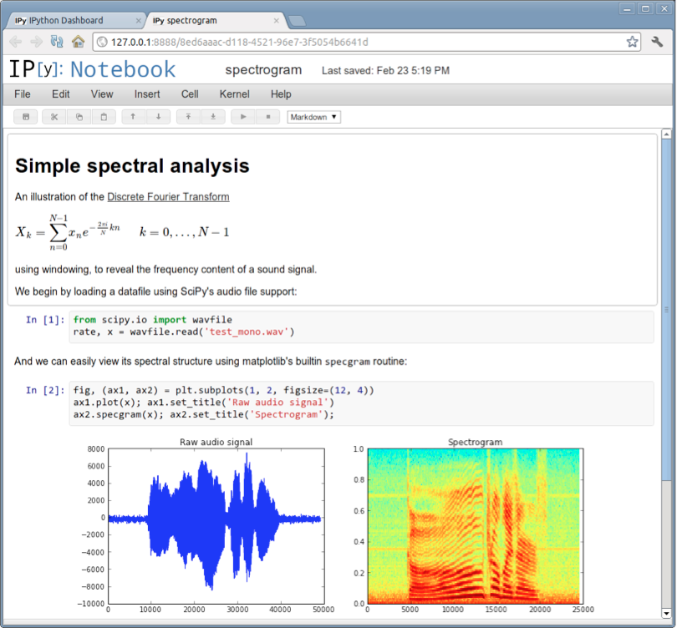
Let’s move to a modern notebook
ipython.org

Slide 7
IPython Notebook
What you can do:
Log your research
Embed your images and videos
Explore your data
Plot your data
Statistically analyze your data
Present your research (slides mode soon!)
All in the same notebook
… for FREE!

